Slide 1
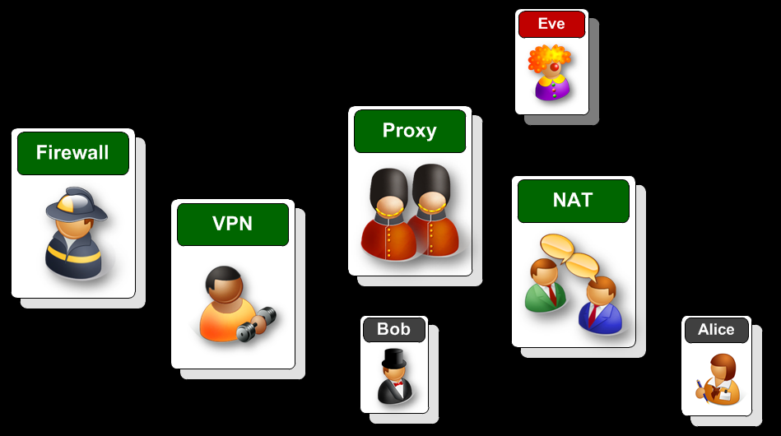
Cyber Workshop
Introduction to Network Security
Robert Ludwiniak

Slide 2
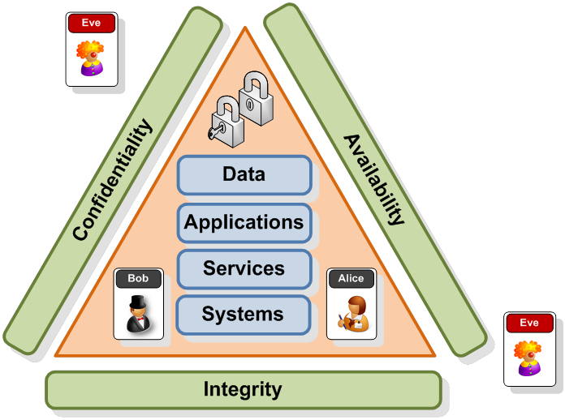
Key Principle Behind Security
Introduction
CSN11111

Slide 3
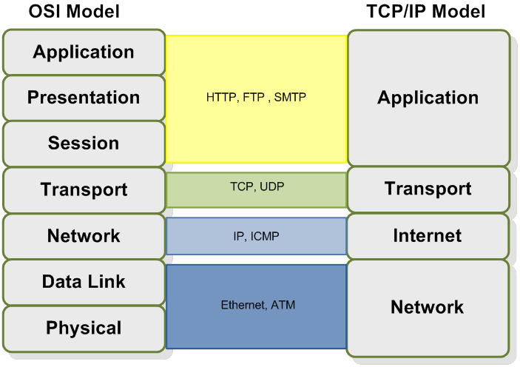
Networking – Layer Approach
Introduction
CSN11111

Slide 4
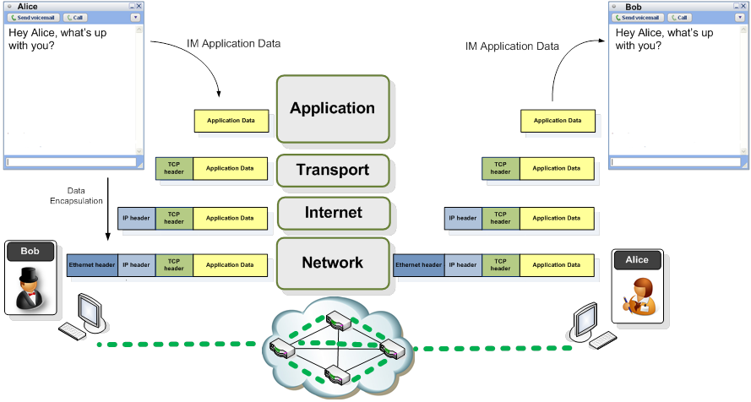
Data Exchange (Encapsulation)
Introduction
CSN11111

Slide 5
CSN11111 – Network Security
Basic Networking Concepts
Robert Ludwiniak

Slide 6
Networking Protocols
Introduction
CSN11111

Slide 7
Example Infrastructure
Introduction
CSN11111

Slide 8
Ethernet, IP and TCP
Introduction
CSN11111

Slide 9
Network IP Address
Introduction
CSN11111

Slide 10
TCP – Client/Server
Introduction
CSN11111

Slide 11
DNS Operation
Introduction
CSN11111

Slide 12
ARP Operation
Introduction
CSN11111

Slide 13
ICMP Operation
Introduction
CSN11111

Slide 14
HTTP Operation
Introduction
CSN11111

Slide 15
Cyber Workshop
Networking Devices
Robert Ludwiniak

Slide 16
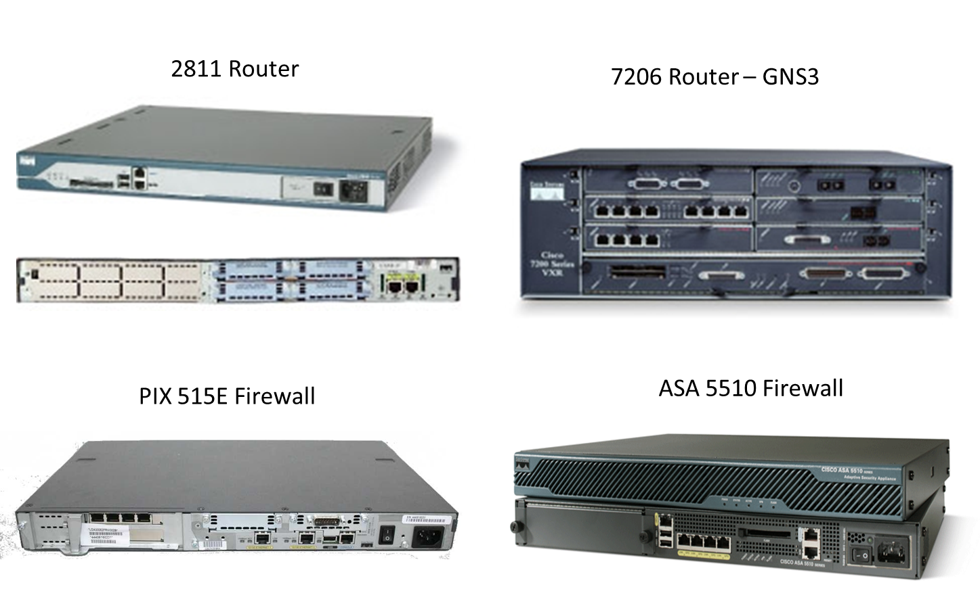
Networking Devices - Cisco
Introduction
CSN11111

Slide 17
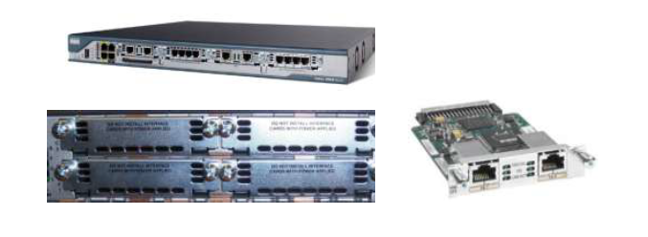
Networking Device Interfaces
Devices configurable Interfaces
Interfaces grouped onto cards or ‘slots’
Introduction
CSN11111

Slide 18
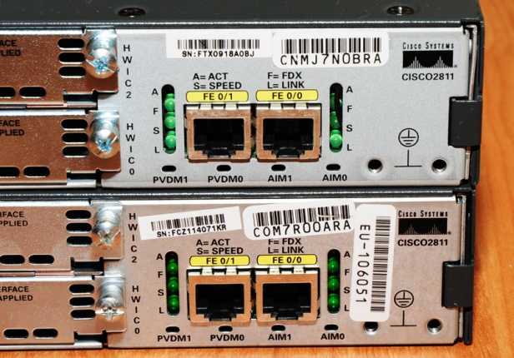
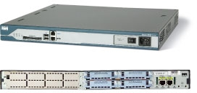
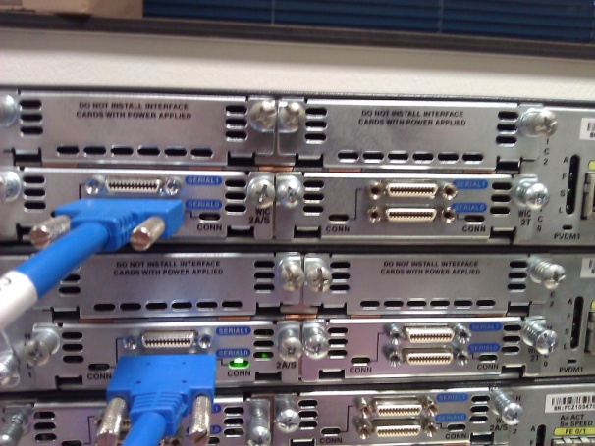
Networking Device Interfaces
Ethernet Interface
Introduction
Slot 3
Slot 2
Slot 1
Slot 0
Serial Interface
(slot 0, 1, 2, 3)
Module 1
Module 0
CSN11111
Router(config)#interface name module/slot/port
Router(config)#interface serial 0/0/0

Slide 19
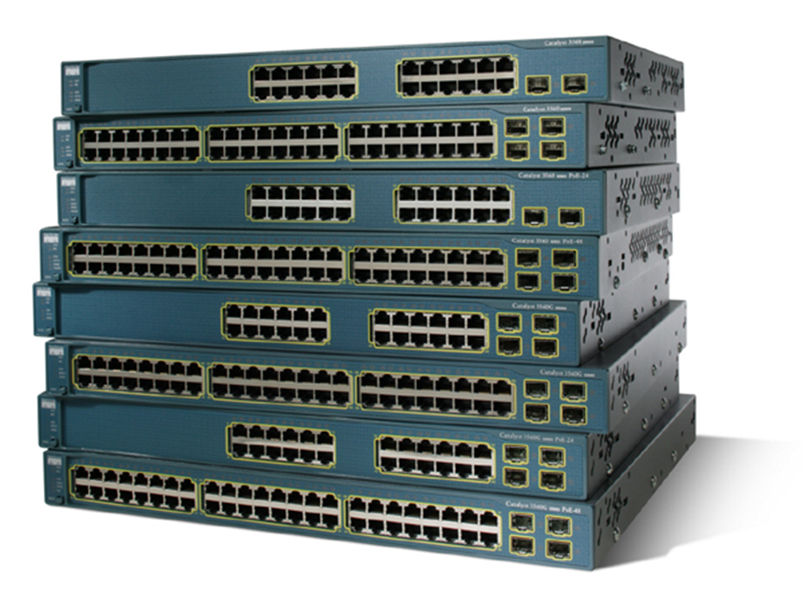
Network Devices - Switches
Introduction
CSN11111

Slide 20
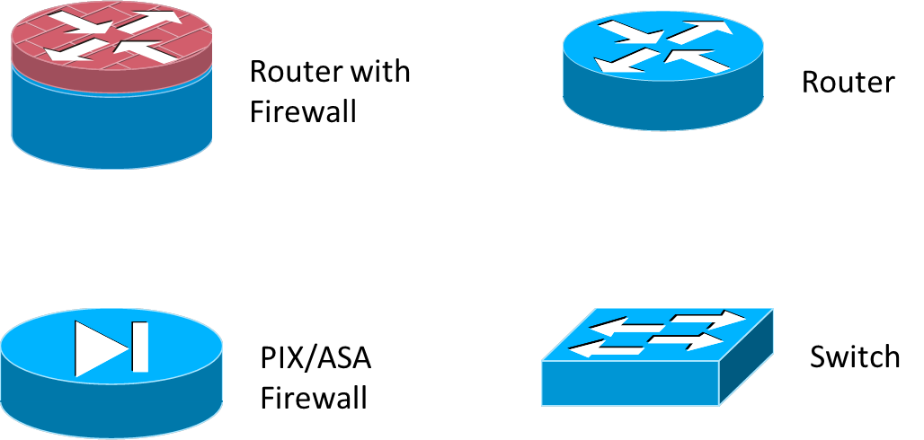
Cisco Devices - Symbols
Introduction
CSN11111

Slide 21
Configuration
A basic router configuration should contain the following:
Router name - Host name should be unique
Banner - At a minimum, banner should warn against unauthorized use
Passwords - Use strong passwords
Interface configurations - Specify interface type, IP address and subnet mask. Describe purpose of interface. Issue no shutdown command. If DCE serial interface issue clock rate command.
After entering in the basic configuration the following tasks should be completed
Verify basic configuration and router operations.
Save the changes on a router
Introduction
CSN11111

Slide 22
Configuration - verification
Verify Basic Router/Switch Configuration
Issue the show running-config command
Save the basic router configuration by Issuing the copy running-config startup-config command
Additional commands that will enable you to further verify router configuration are:
Show running-config - Displays configuration currently in RAM
Show startup-config - Displays configuration file NVRAM
Show IP route - Displays routing table
Show interfaces - Displays all interface configurations
Show IP interface brief - Displays abbreviated interface configuration information
Introduction
CSN11111

Slide 23
Cisco Device Command Modes
Introduction
CSN11111

Slide 24
Changing prompt mode
Introduction
CSN11111

Slide 25
Error notification
Introduction

